Slide 1
PROJECT - 6
NextHikes IT Solutions Project 6: Sales Forecasting Across Multiple Retail Stores - Overview
Name – SANTOSH
Mobile no – 8377011874
Batch - Digicrome Academy | Data Science and AI | N-140724-E8-SS-27
T

Slide 2
Start from here Business Need You work at Nexthikes as a Machine Learning Engineer and a company called Rossmann Pharmaceuticals has given you a project on sales forecasting. The finance team wants to forecast sales in all their stores across several cities six weeks ahead of time. Managers in individual stores rely on their years of experience as well as their personal judgement to forecast sales. The data team identified factors such as promotions, competition, school and state holidays, seasonality, and locality as necessary for predicting sales across the various stores

Slide 3
Data and Features Id - an Id that represents a (Store, Date) duple within the test set Store - a unique Id for each store Sales - the turnover for any given day (this is what you are predicting) Customers - the number of customers on a given day Open - an indicator for whether the store was open: 0 = closed, 1 = open Learning Outcomes - Technical Skills: Pandas, Matplotlib, Numpy, HTML and CSS ,Flask. Interns will also improve their code modularization skills. – Creation of new features - Predictive pipeline: Exploratory data analysis, data wrangling, building and fine-tuning models – Building model using MLOps Techniques - Deployment: Interns will know how to serve predictions in a web app.

Slide 4
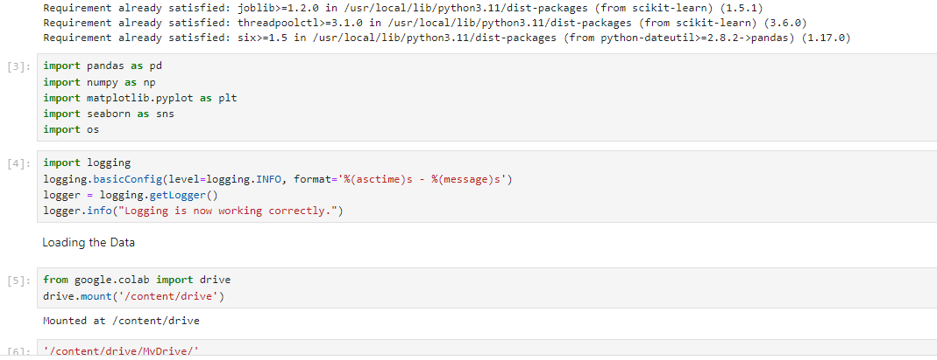
Import required libraries

Slide 5
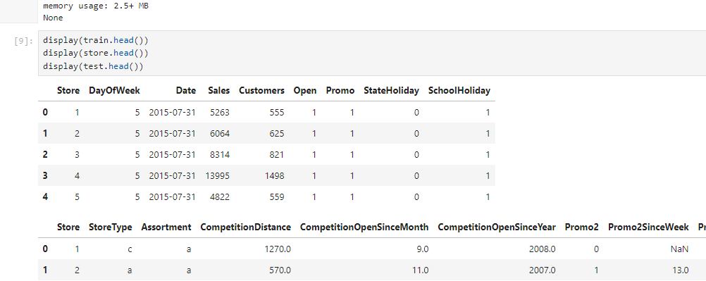
Tasks

Slide 6
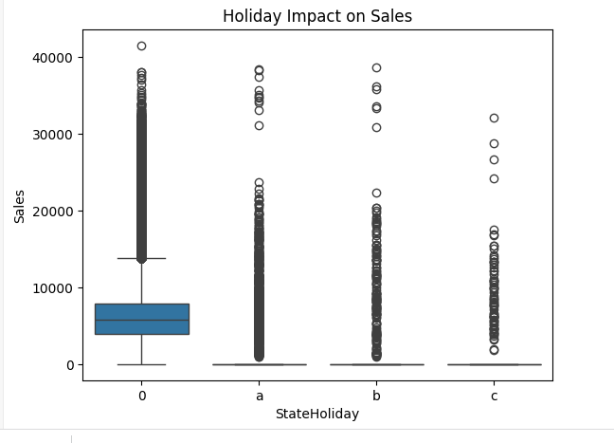

Slide 7
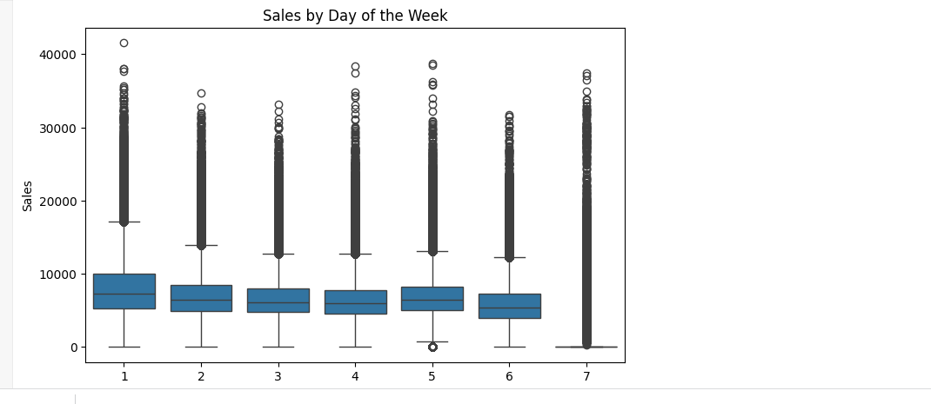

Slide 8
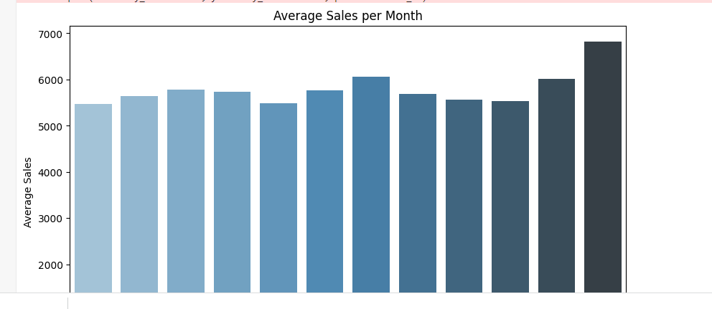
import calendarplt.figure(figsize=(10, 6))sns.barplot(x=monthly_sales.index, y=monthly_sales.values, palette="Blues_d")plt.title("Average Sales per Month")plt.xlabel("Month")plt.ylabel("Average Sales")plt.xticks(ticks=range(12), labels=calendar.month_name[1:], rotation=45)plt.show()

Slide 9
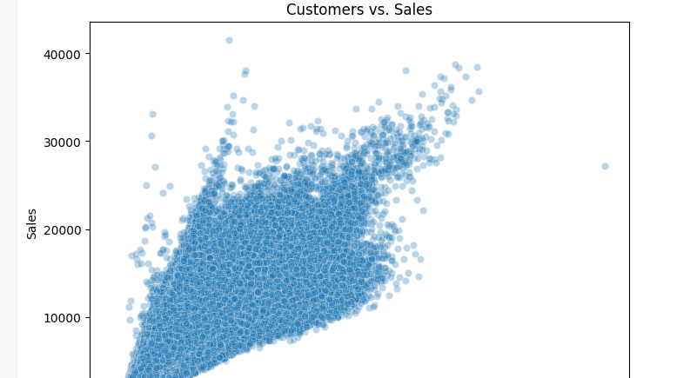
Customer VS Sales

Slide 10
THANKYOU

